Slide 1
Network-based association study of protein sets and applications in gene ontology enrichment analysis
Hao-Bo Guo
College of Engineering and Computer Science
SimCenter
The University of Tenness at Chattanooga

Slide 2
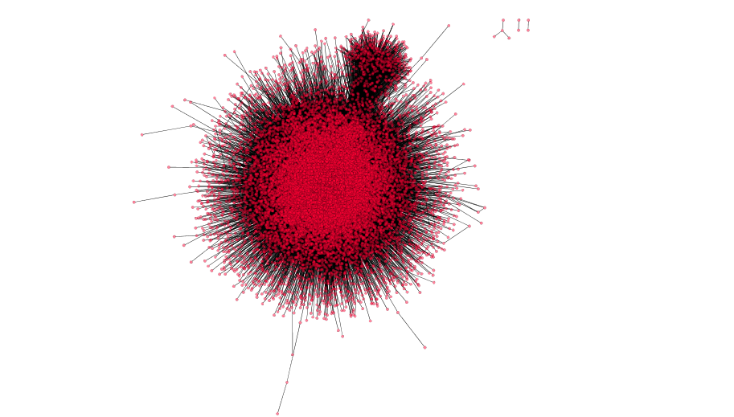
Methods and Resources
Biological Process (BP): 11,883 terms
Cellular Component (CC): 1,704 terms
Molecular Function (MF): 4,128 terms
Li et al. Nature Methods 2017
InWeb_InBioMap
16,641 vertices
592,685 edges
50 HALLMARK protein sets
Null (MS02) permutations: randomly reshuffle partners with node degrees preserved

Slide 3
Scheme
HALLMARK_OXIDATIVE_PHOSPHORYLATION
GO:0015990 (“electron transport coupled proton transport”)
Functional neighbor subnetwork (S_{i}):
functional term f_{i} (GO, pathway) ←→ protein set
The edge number (E_{i}) of S_{i} reflects the strength of this interaction

Slide 4
Table 1. Summary of the 50 hallmark protein sets from MSigDB (5 listed)
Set | V | E | Iso | D_{max} | CC | Clust | Cliq | R | B | Y | J_{BP} | J_{CC} | J_{MF} | BP_{max} | CC_{max} | MF_{max}
1 | 200 | 445 | 29 | 159 | 0.123 | 171 | 10 | 49 | 37 | 6 | 0.07 | 0.13 | 0.09 | 18.434 | 26.675 | 18.010
2 | 200 | 616 | 26 | 40 | 0.398 | 166 | 11 | 103 | 63 | 23 | 0.18 | 0.2 | 0.2 | 55.890 | 50.323 | 46.862
3 | 101 | 55 | 52 | 10 | 0.132 | 39 | 3 | 27 | 2 | 0 | 0.03 | 0.11 | 0.1 | 13.983 | 9.221 | 13.150
4 | 36 | 25 | 16 | 6 | 0.224 | 20 | 3 | 22 | 361 | 4 | 0.09 | 0.15 | 0.09 | 32.793 | 23.620 | 24.619
5 | 200 | 570 | 42 | 32 | 0.299 | 150 | 7 | 121 | 190 | 9 | 0.15 | 0.27 | 0.14 | 36.113 | 40.408 | 38.653
List of protein sets: 1. HALLMARK_ADIPOGENESIS, 2. HALLMARK_ALLOGRAFT_REJECTION, 3. HALLMARK_ANDROGEN_RESPONSE, 4. HALLMARK_ANGIOGENESIS, 5. HALLMARK_APICAL_JUNCTION, … …
Set: protein sets 1-50; V: vertex number; E: edge number; Iso: number of isolated proteins; D_{max}: maximal vertex degree; CC: cluster coefficient (global); Clust: maximal cluster size; Cliq: maximal clique degree; R: number of R-proteins (type-1, Red); B: number of B-proteins (type-2, Blue); Y: number of Y-proteins (type-3, Yellow); J_{BP}: Jaccard index of enriched BP terms between NetBAS and DAVID; J_{CC}: Jaccard index of enriched CC terms between NetBAS and DAVID; J_{MF}: Jaccard index of enriched MF terms between NetBAS and DAVID; BP_{max}: z_{max} for BP terms; CC_{max}: z_{max} for CC terms; MF_{max}: z_{max} for MF terms.

Slide 5
Pairwise correlations of selected features of the subnetwork within the protein sets and enrichment results
✓
✓
✓
✓
✓
✓
✓
✓
✓
✓
✓
✓
✓
✓
✓
✓
✓
✓
✓
✓
✓
✓
✓
✓
✓
✓
✓
✓
✓
✓
✓
✓
✓
“✓” :
positive correlation with p < 0.05
✓
✓
✓
✓
✓
✓
✓
✓
✓
✓
✓
✓
✓
✓
✓
✓
✓
✓
✓
✓
✓
✓
✓

Slide 6
Contributions from the maximal cluster
GO:1902287
(“semaphorin-plexin signaling pathway involved in axon guidance”)
9 in 10 overlap

Slide 7
Contributions from the largest clique
GO:0007218 (“neuropeptide signaling pathway”)
8 in 10 overlap

Slide 8
Contributions from the largest clique

Slide 9
Three groups of protein sets
R
B
Y
R (type 1): proteins from set P but do not carry f_{i}
B (type 2): proteins carry f_{i} but do not belong to set P
Y (type 3): protein belong to set P and carry f_{i}
Figure 3. K-means clustering of the protein distributions in the functional neighbor subnetworks of S_{BP1} resulted in three groups from the 50 hallmark protein sets. (A) Cluster I includes 26 sets in which S_{BP1} is dominated by type-2 proteins (blue) that are significantly more than type 1 (red) or type 3 (yellow) proteins. Two examples of S_{BP1} from set 4 and set40 are shown. Set 4 has four Y-type proteins with degrees k(APP)=333, k(PF4)=191, k(CXCL6)=188, and k(VAV2)=14, respectively. The single R-type protein in set40 is GNGT1 with k=377.

Slide 10
Three groups of protein sets
B
R
Y
R (type 1): proteins from set P but do not carry f_{i}
B (type 2): proteins carry f_{i} but do not belong to set P
Y (type 3): protein belong to set P and carry f_{i}
Figure 3. (continued) (B) Cluster II includes 12 sets in which numbers of type I and type II proteins in S_{BP1} are close to each other, and both are larger than that of type III proteins. Two examples of S_{BP1} from set1 and set27 are shown.

Slide 11
Three groups of protein sets
R
B
Y
Figure 3. (continued) (C) Cluster III includes 12 sets in which type I proteins are higher than type 2 or type 3 proteins in S_{BP1}. Two examples of S_{BP1} from set7 and set3 are shown. Set3 is an extreme case and the only protein set that none of the top-10 enriched BP terms by NetBAS has been captured by DAVID.

Slide 12
Three groups of protein sets
Table 2. Average properties of the three groups of protein sets
Group | R | B | Y | Cliq | Clust | BP_{max} | CC_{max} | MF_{max} | J_{BP} | J_{CC} | J_{MF}
G1 | 59.77 | 211.69 | 15.62 | 7.27 | 72.5 | 40.39 | 31.76 | 34.52 | 0.10 | 0.14 | 0.11
G2 | 48.33 | 48.17 | 9.33 | 9.42 | 107.83 | 34.34 | 30.75 | 33.61 | 0.10 | 0.13 | 0.11
G3 | 70.58 | 35.58 | 16.25 | 15.75 | 133.42 | 54.1 | 47.65 | 43.41 | 0.12 | 0.17 | 0.14
Average values for all protein sets in the cluster. R: number of R-proteins (type-1, Red); B: number of B-proteins (type-2, Blue); Y: number of Y-Proteins (type-3, Yellow); Cliq: maximal clique degree; Clust: maximal cluster size; BP_{max}: z_{max} for BP terms; CC_{max}: z_{max} for CC terms; MF_{max}: z_{max} for MF terms; J_{BP}: Jaccard index of BP terms between DAVID and NetBAS; J_{CC}: Jaccard index of CC terms between DAVID and NetBAS; J_{MF}: Jaccard of MF terms between DAVID and NetBAS.

Slide 13
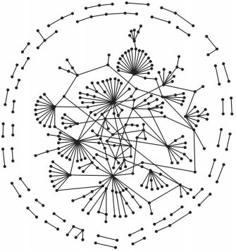
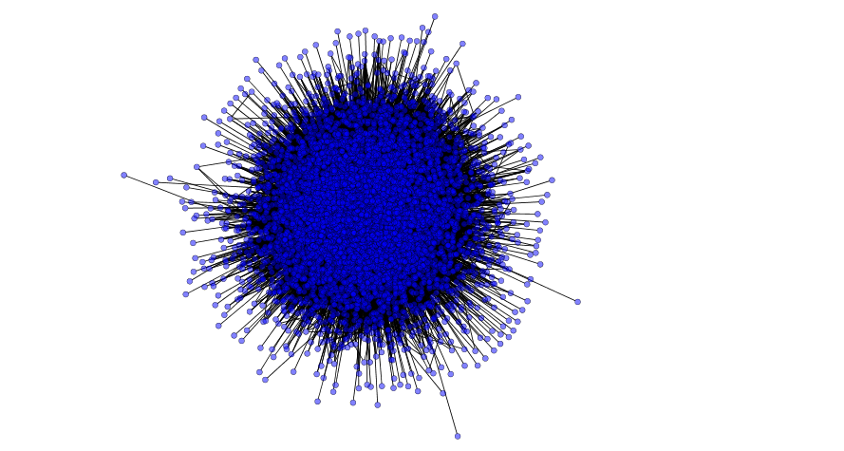
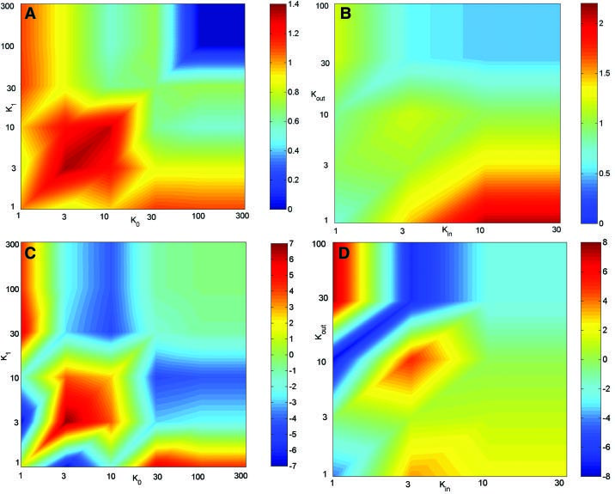
Other applications
Yeast PIN
BioGRID 3.4.163 (Aug. 2018)
102,790 edges
5,777 vertices
Maslov & Sneppen, Science 2002

Slide 14
Other applications
NetBAS can be applied for combinations of various categorical and/or quantitative genomic, proteomic, transcriptomic, … data

Slide 15
Summary
We present a computational framework of network permutation-based association study (NetBAS) that can evaluate association of gene ontology (GO) terms of an input list of protein genes to other genomic data in the context of human protein-protein interaction networks (hPINs). In contrast to other methods, NetBAS evaluate the pairwise associations of genomic data based on gene/protein interactions. NetBAS compares observed frequencies of interacting pairs of categorical values in the empirical networks such as hPINs to those in network null models. The statistical significance of observed interacting frequencies are evaluated by Z-scores to infer over- and under-representations. We tested 50 hallmark sets from MSigDB using NetBAS. We found that the modular structures of the subnetworks constituted by the protein sets strongly influence the enrichment scores. We demonstrated the utility of NetBAS through comparison with two other tools, a modular enrichment tool, DAVID, and a network-topology-based tool, WebGestalt. We showed that NetBAS results depends on the subnetwork-architecture and can offer complement insights to existing GO enrichment analysis. Moreover, NetBAS can be applied to analyze other categorical or quantitative data associated with protein sets

Slide 16
Acknowledgements
Univ. Tennessee Chattanooga
Dr. Hong Qin
This work is supported by the NSF Career award #1453078 (transferred to #1720215), Dr. H.Q.
All simulations have been performed on the Ts117 server at SimCenter, University of Tennessee Chattanooga

